Slide 1


Model Deployment in Python
Presenter: Shaimaa Alghamdi

Slide 2
What is the Model Deployment?
Criteria of ML Model Before Deployment.
Steps for Deploying ML Models Into Production.
Common Ways To Deploy ML Models.
Fish Weight Prediction Application – DEMO
References
OUTLINES

Slide 3
What Model Deployment?
To integrate a machine learning model into an existing production environment where it can take in an input and return an output.

Slide 4
Criteria of ML Model Before Deployment
Portability
01
To the ability of your software to be transferred from one machine or system to another.
Scalability
Refers to how large your model can scale
02

Slide 5
Four Steps for Deploying Machine Learning Models Into Production
Train the model (This involves selecting an algorithm, setting its parameters, and training it on prepared, cleaned data)
01
Prepare To Deploy the ML Model
Validation includes testing the model on a fresh data set and comparing the results to its initial training.
Validate the ML Model
02
03
Move the model to a production environment where resources are streamlined and controlled for safe and efficient performance.
Deploy the ML Model
Model monitoring ensures that the model is working properly and that its predictions are effective over time.
Monitor the ML Model
04
Notes:
فيه هنا ٠٤ إضافات اذا ابيها كأسئله..

Slide 6
Steps of Deploy The ML Model
The process of actually deploying the model requires several different steps or actions
01
The model needs to be moved into its deployed environment.
02
The model needs to be integrated into a process.
03
The people who will be using the model need to be trained in how to activate it, access its data, and interpret its output.

Slide 7
Two Common Ways To Deploy ML Models
Batch inference
Online inference
Also called real-time inference or dynamic inference. These predictions are generated on a single observation of data at runtime.
Since it should provide results in real-time, you cannot use complex models with online inference.
Also called offline inference, is the process of generating predictions on a batch of observations. The batch jobs are typically generated on some recurring schedule (e.g. hourly, daily).
There is no constraint, you can deploy more complex models that can provide more accurate results.

Slide 8

Fish Fish Weight Prediction Application - DEMO
A faster way to build and share data apps.
Streamlit turns data scripts into shareable web apps in minutes.
No front‑end experience required.
STREAMLIT
Notes:
There are three main python files to build the application

Slide 9
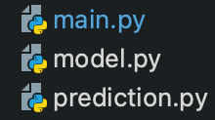
Fish Fish Weight Prediction Application - DEMO
To Run The Web App
To Build ML Model And Save It
Test Saved ML Model
Notes:
There are three main python files to build the application

Slide 10
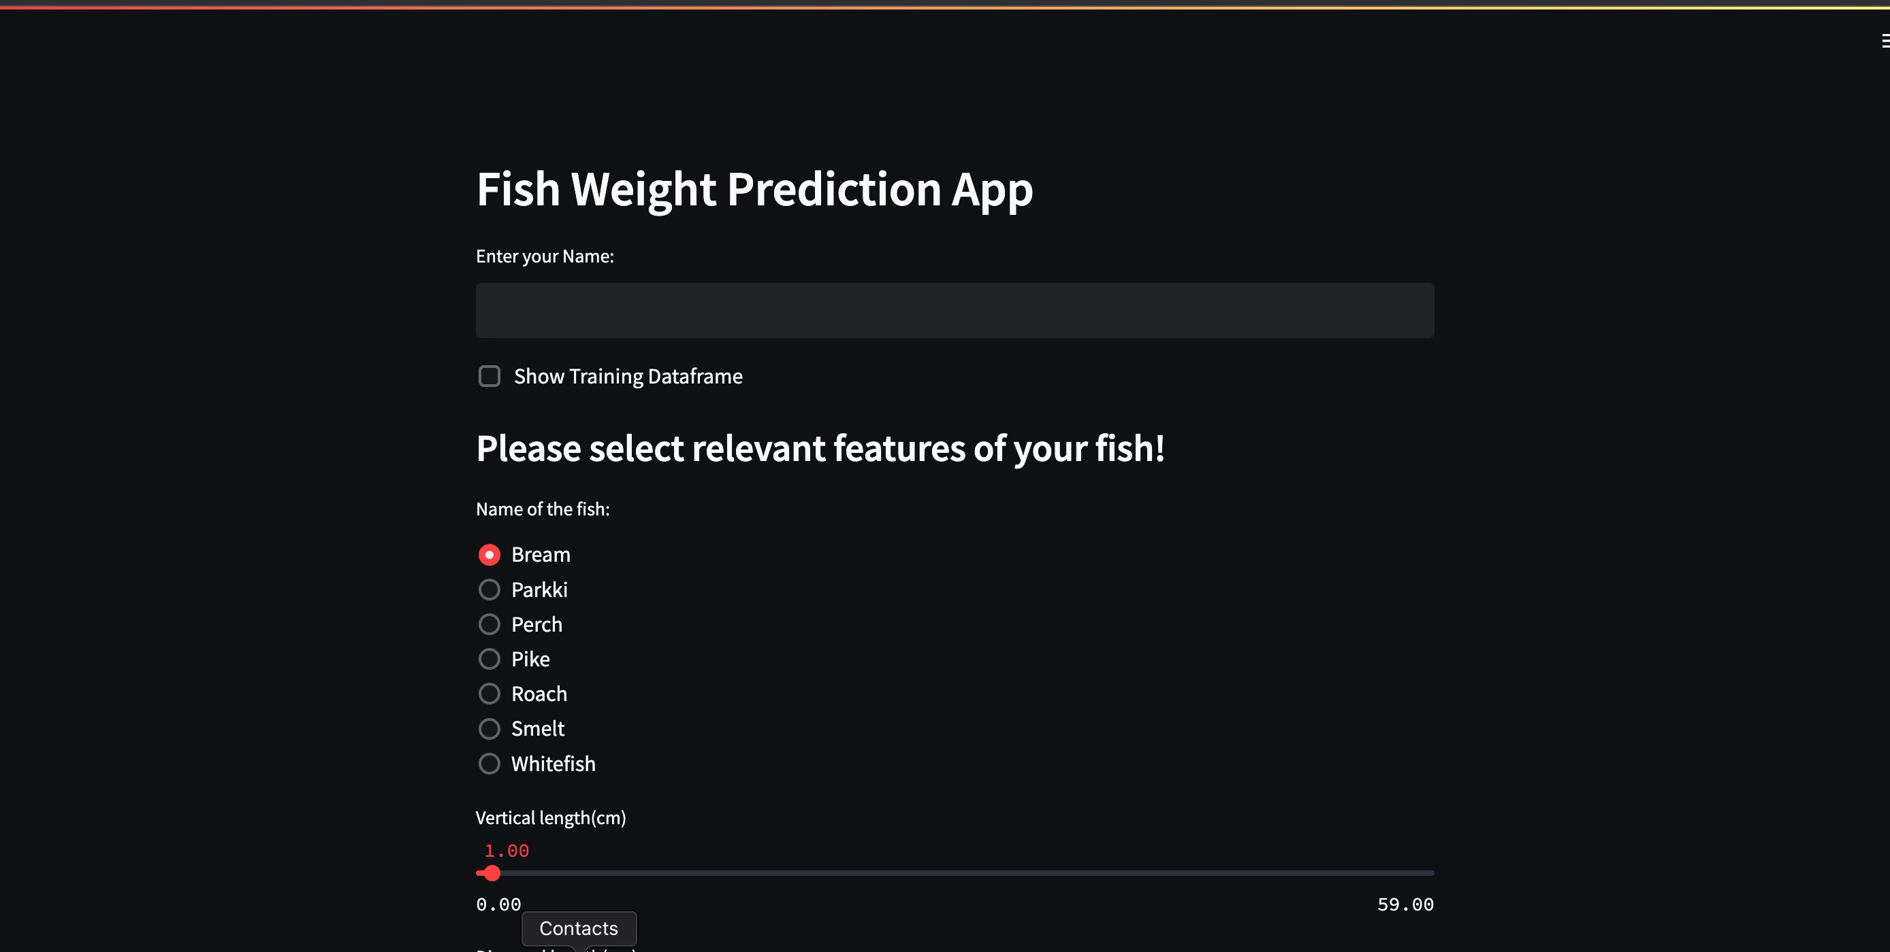
Fish Fish Weight Prediction Application - DEMO
TO TEST THE DEMO, FOLLOW THESE STEPS :
1. Cloning a repository [DEMO]
2. Using the Terminal:
1.1 Install necessary libraries
pip install requirements.txt
Notes:
There are three main python files to build the application

Slide 11
Fish Fish Weight Prediction Application - DEMO
TO TEST THE DEMO, FOLLOW THESE STEPS:
1. Cloning a repository [DEMO]
2. Using the Terminal:
1.2 Run the Streamlit tool
streamlit run main.py
Notes:
There are three main python files to build the application

Slide 12
REFERENCES
3 Ways to Deploy Machine Learning Models in Production
How to Deploy Machine Learning Models
3 Steps To Efficient Machine Learning Model Deployment
A Guide to Machine Learning Model Deployment
Streamlit Tool
DEMO

Slide 13
THANKS
ANY QUESTIONS

